Slide 1
Java and Web Development
Rent a Car Website
Gıthub repository lınk: https://github.com/ey22/rentacar

Slide 2
Purpose of the Web App
The purpose of this project is to develop a user-friendly car rental platform that allows customers to seamlessly browse, select, and book vehicles based on their preferences. The system includes login and sign-in functionalities to show previous reservations. Customers can filter cars, choose protection plans, and review their reservations in detail.

Slide 3

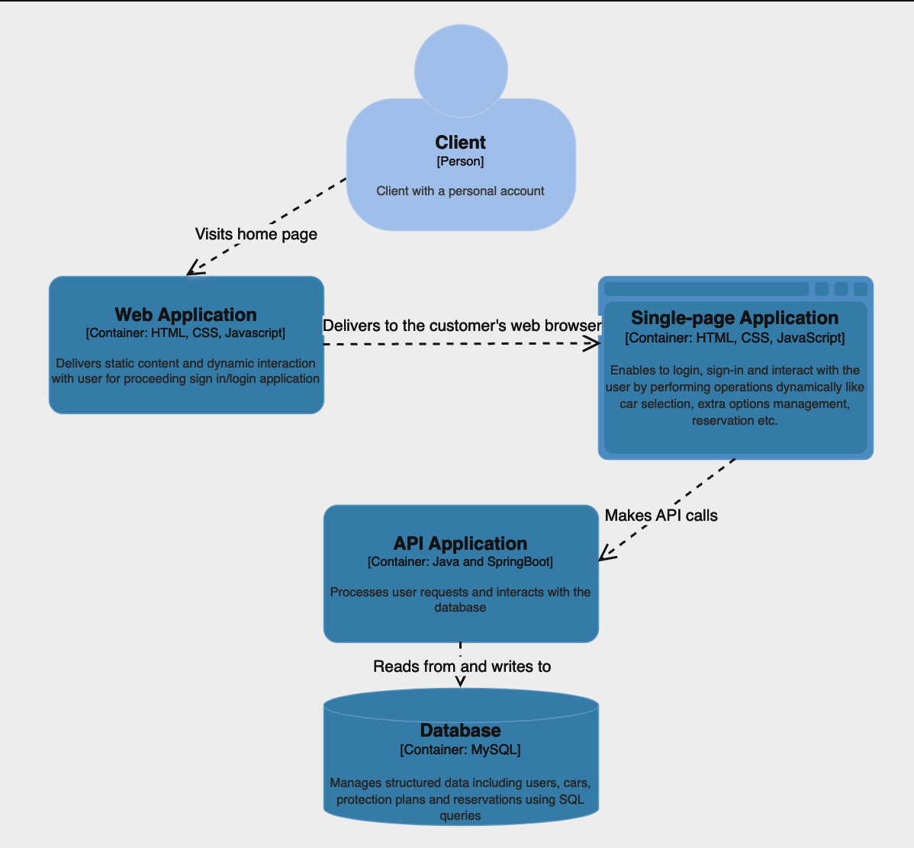
Architecture Diagram

Slide 4
Technologies for Frontend and Backend
Frontend technologies
HTML
CSS
JavaScript
Backend technologies
Java
SpringBoot
MySQL

Slide 5
Test Cases
Page | Action | Expected Result
Main page | Click on the ‘Login/Sign in’ button. | User is redirected to login/sign in page
Login page | Enter a username and password. Click on the ‘Continue’ button. | When data are not provided correctly in login page, alert is raised according to the entered data error. Otherwise, user is redirected to the carOptions page.
Sign in page | Enter a username and password. Click on the ‘Continue’ button. | User’s data is stored in database and user is redirected to the carOptions page.
Car options page - Step 1 | Select location and valid dates. | If both data are provided, step advances to step2. If one is not selected, an alert is raised and cannot proceed to the step2.
Car options page – Step2 | Apply filters for brand and transmission. | Cars matching the filter criteria are displayed. If no match, a message is shown.
Car options page – Step2 | Select a car by clicking the ‘Select’ button. Click ‘Next’ button. | Selected car is displayed under the related stepper. Step advances to Extras. Total price will be visible.
Car options page – Step3 | Select a protection plan by clicking the ‘Select’ button. | Selected protection plan is displayed under the related stepper. Total price updates to include protection plan cost.
Car options page – Step4 | Check the displayed details. And click ‘Complete the reservation’ | Reservation details are sent to the database and stored. Alert is raised to keep you informed.
Car options page – Any step | Click ‘My reservations’ button | Sidebar opens, displaying user's past reservations. If no reservations, displays a message.
All pages | For observing responsive design, open the page on devices with different screen sizes (Feature of Firefox can be used). | Page layout adjusts appropriately for all screen sizes without layout issues.

Slide 6
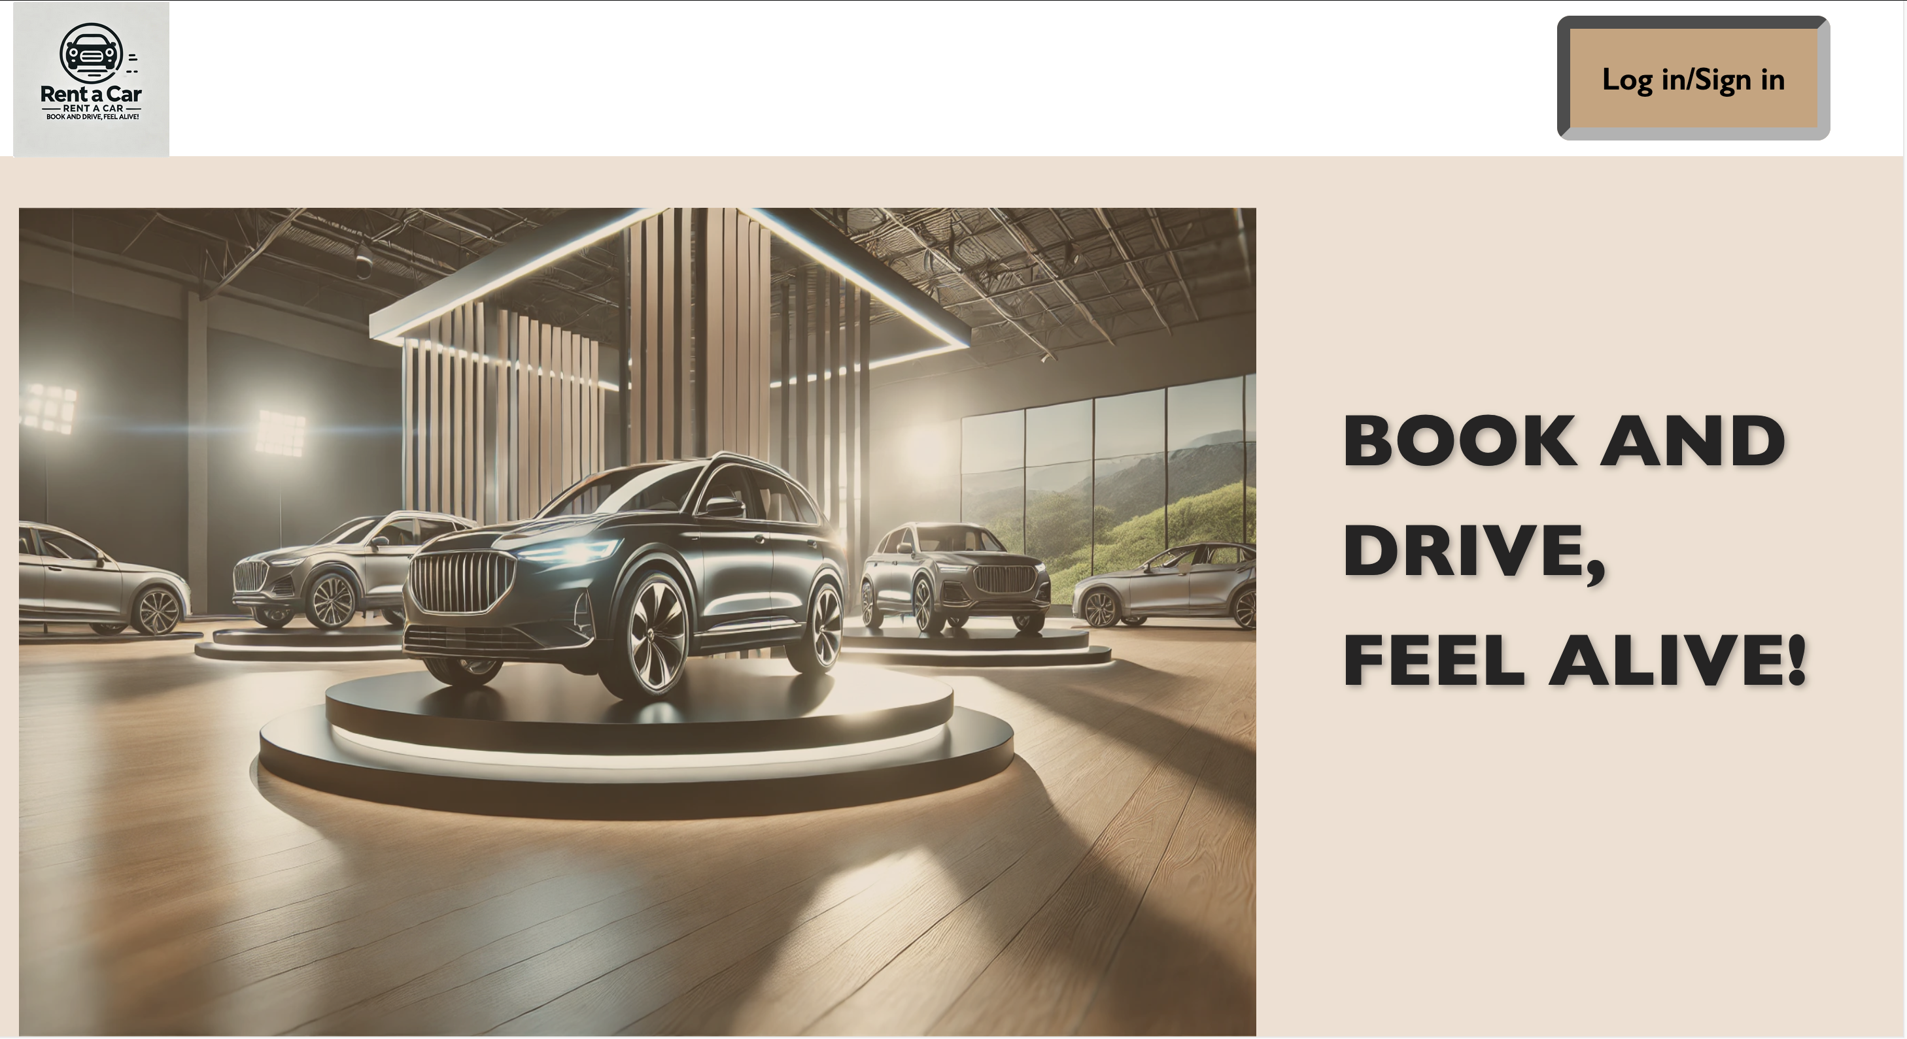
Homepage of the car hire website. Log in if user has an account or sign up to get started.

Slide 7
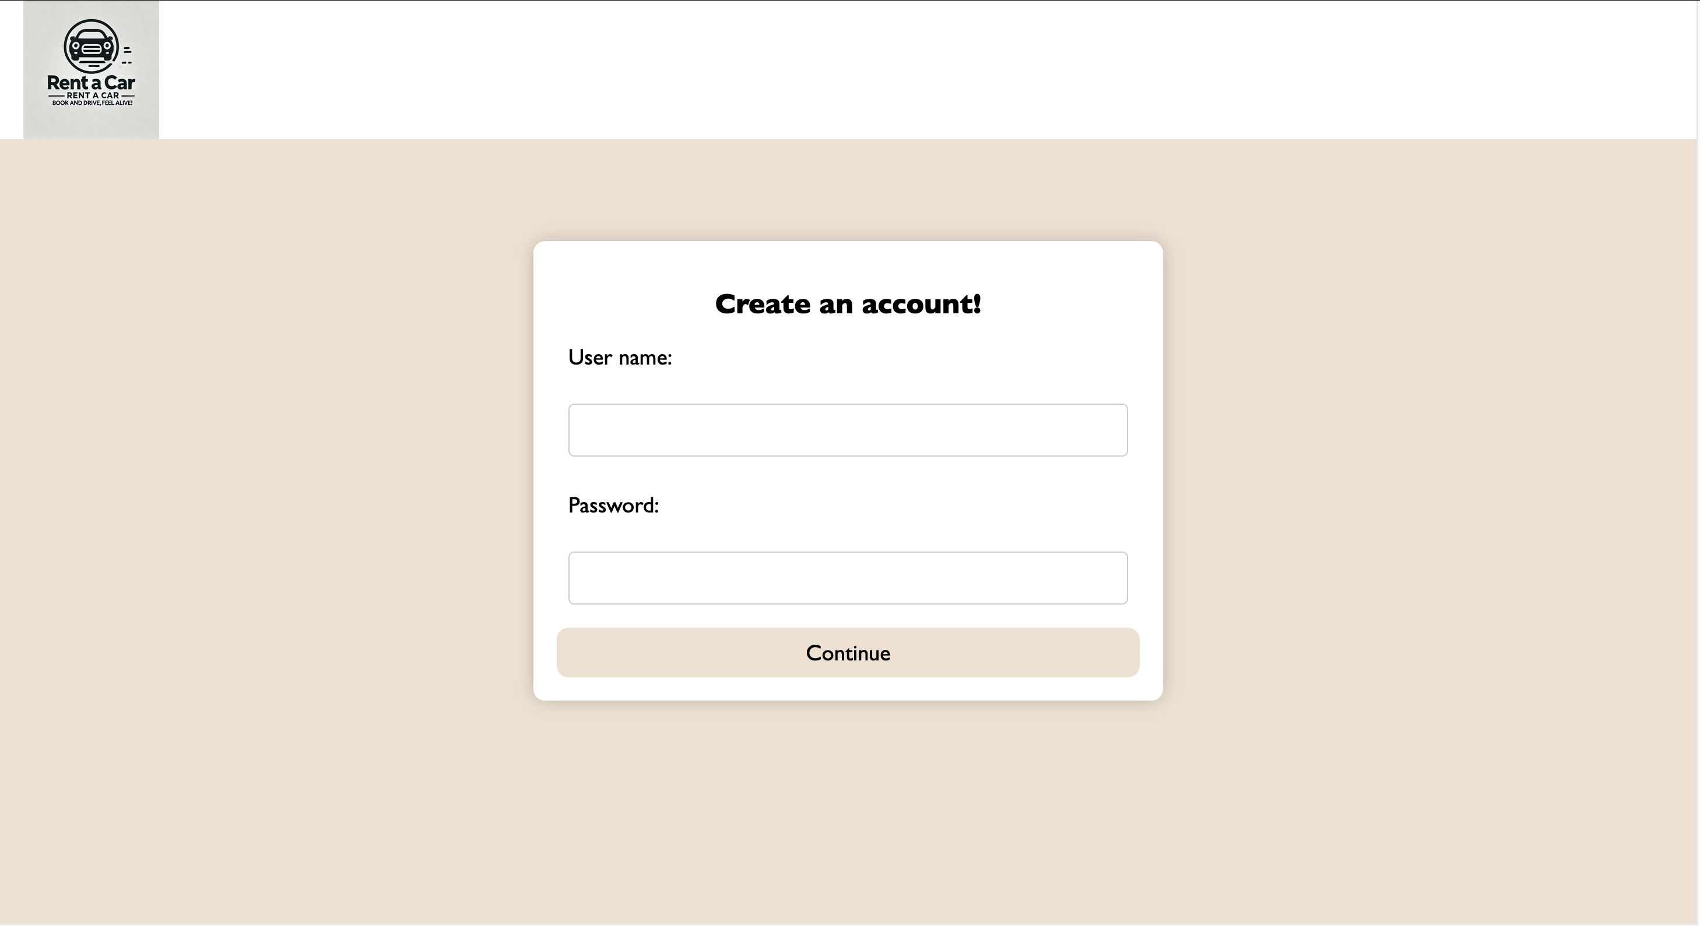
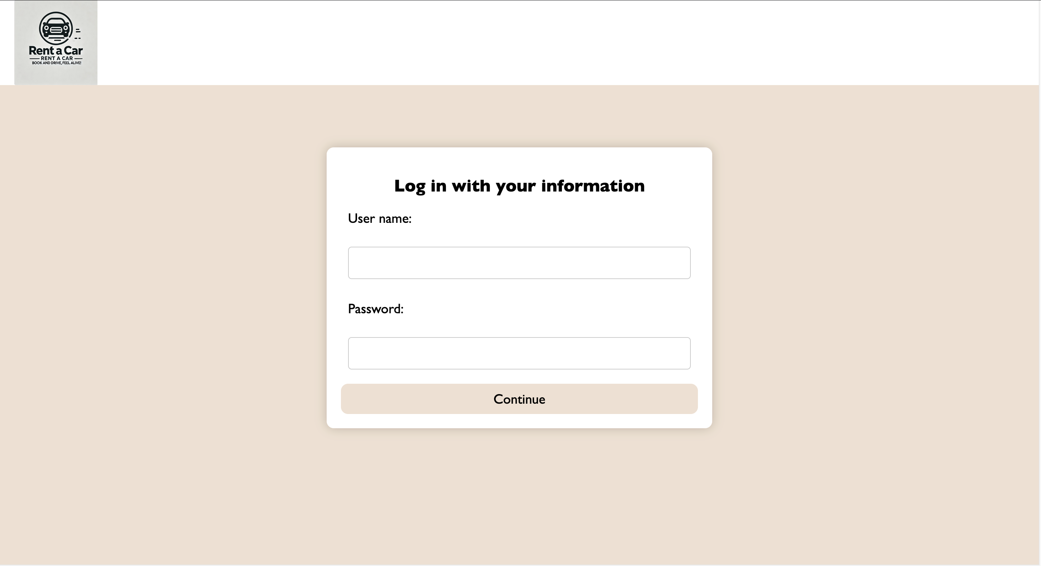
Sign in page to create an account with user name and password
Log in to rent user’s preferred car and track reservations

Slide 8
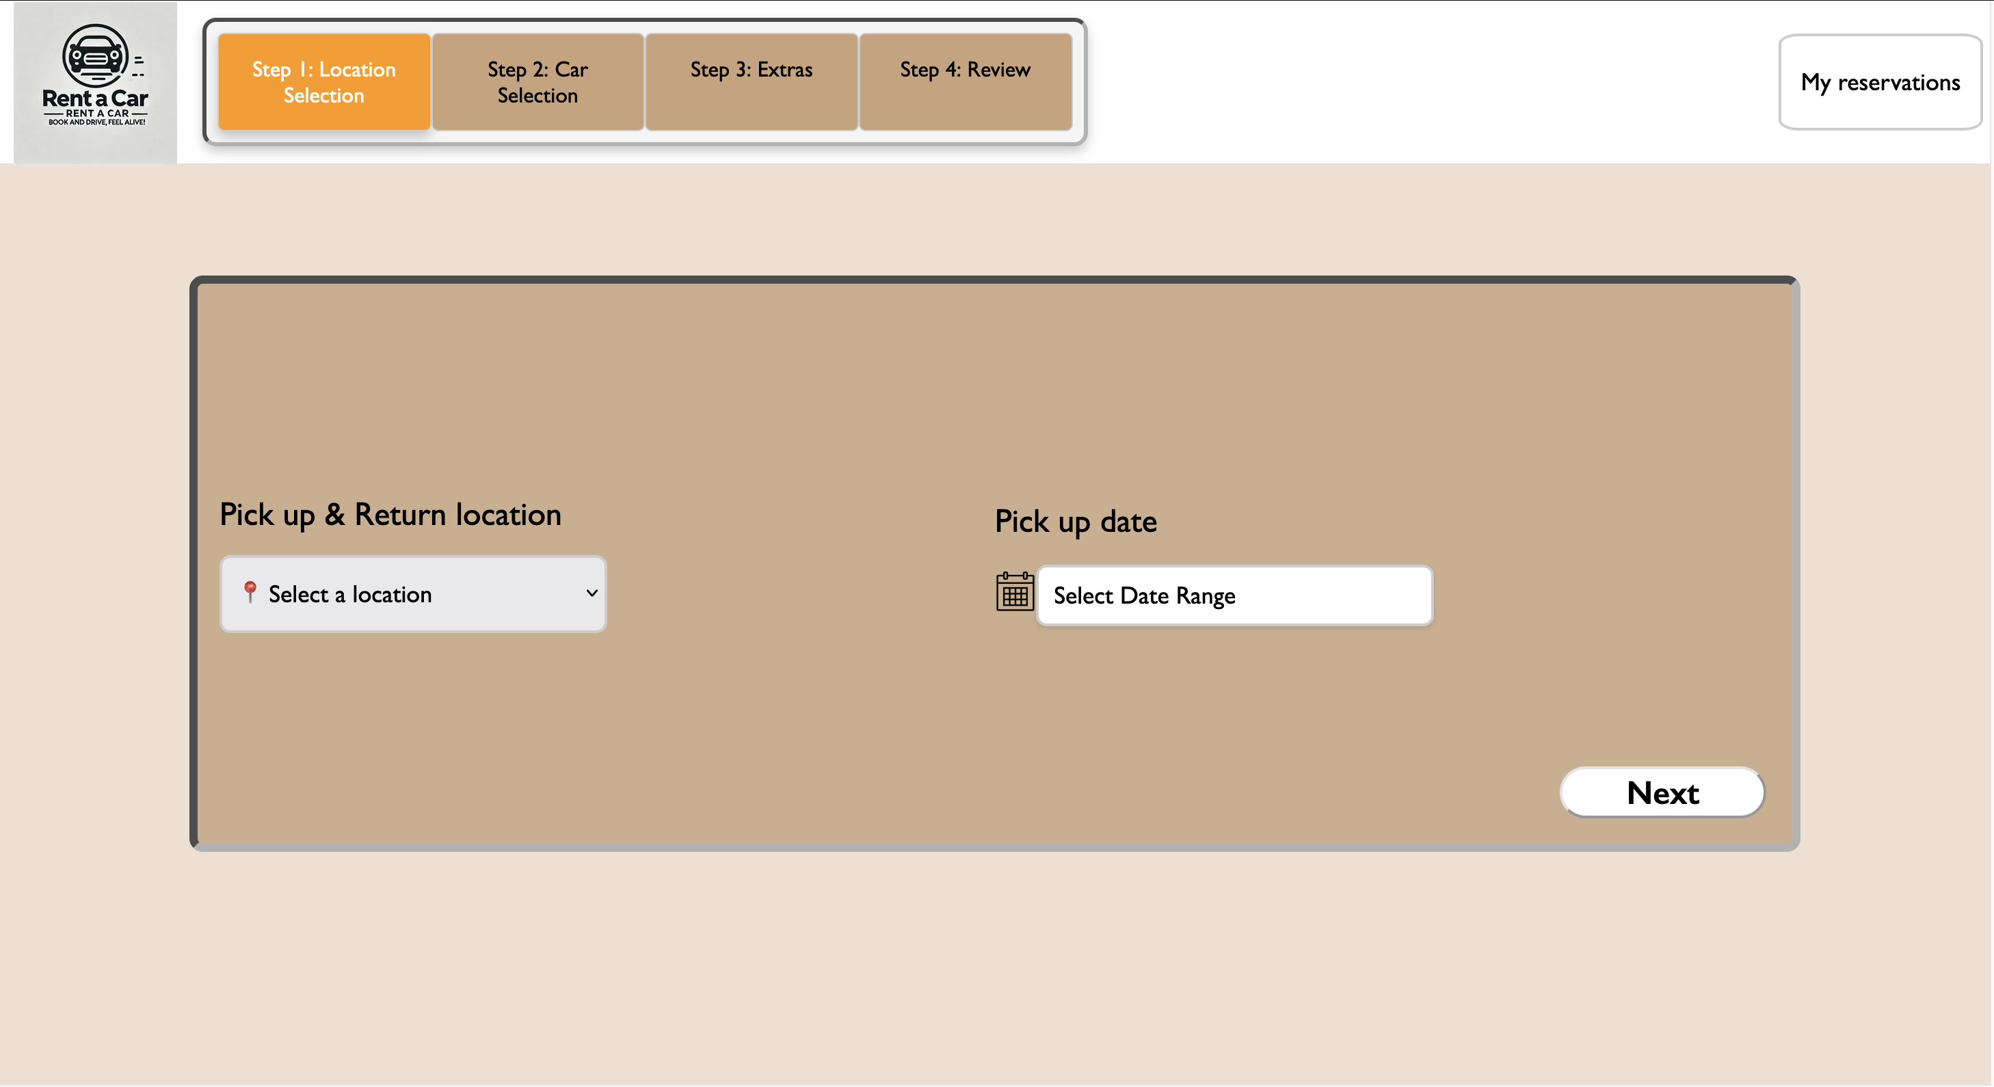
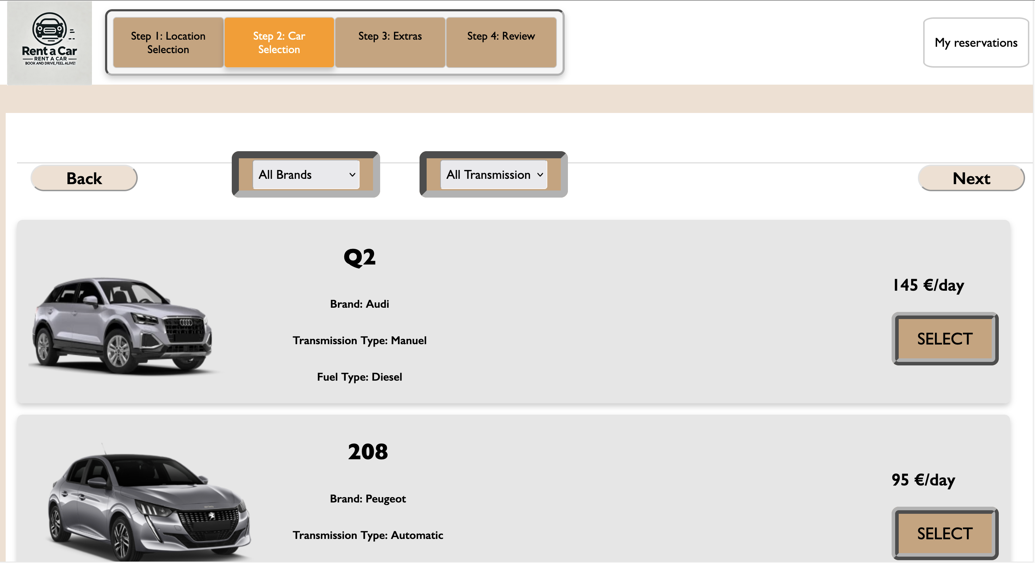
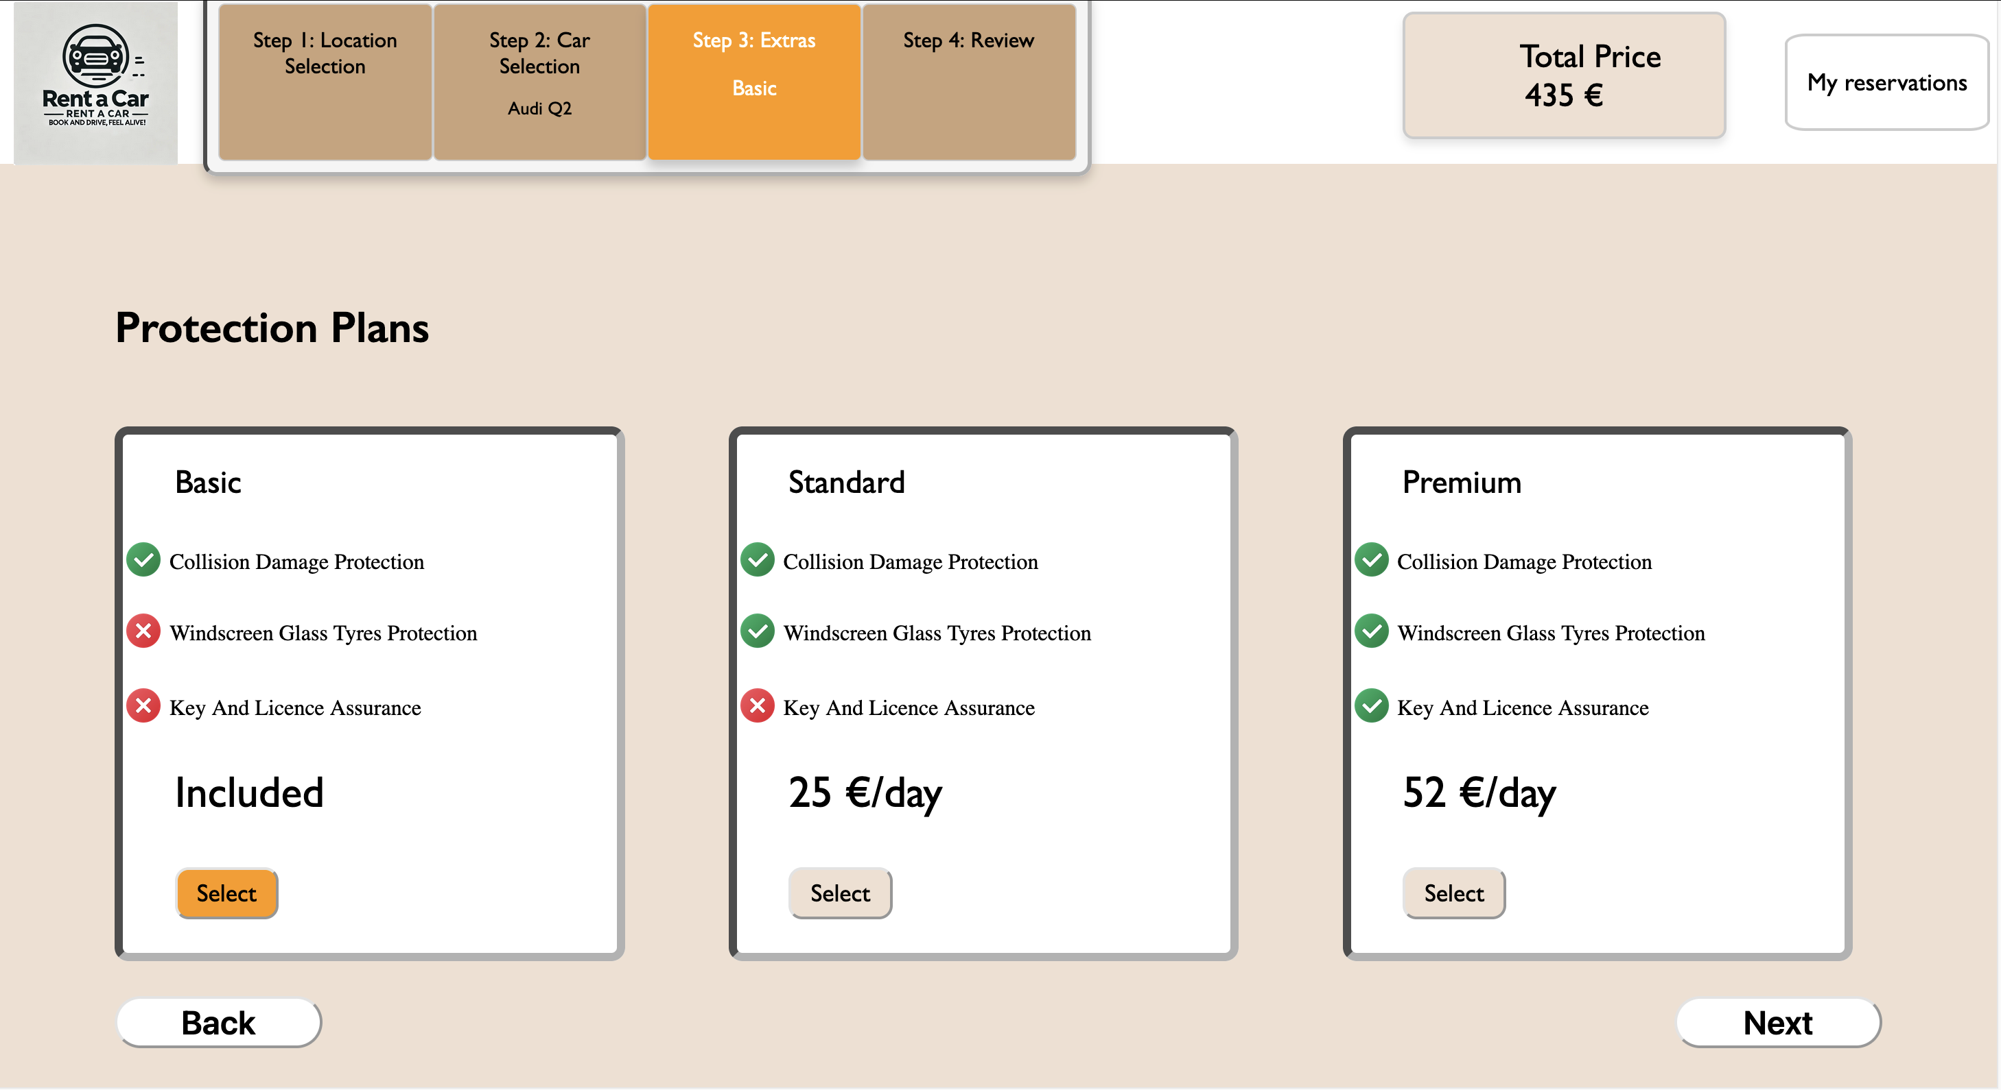
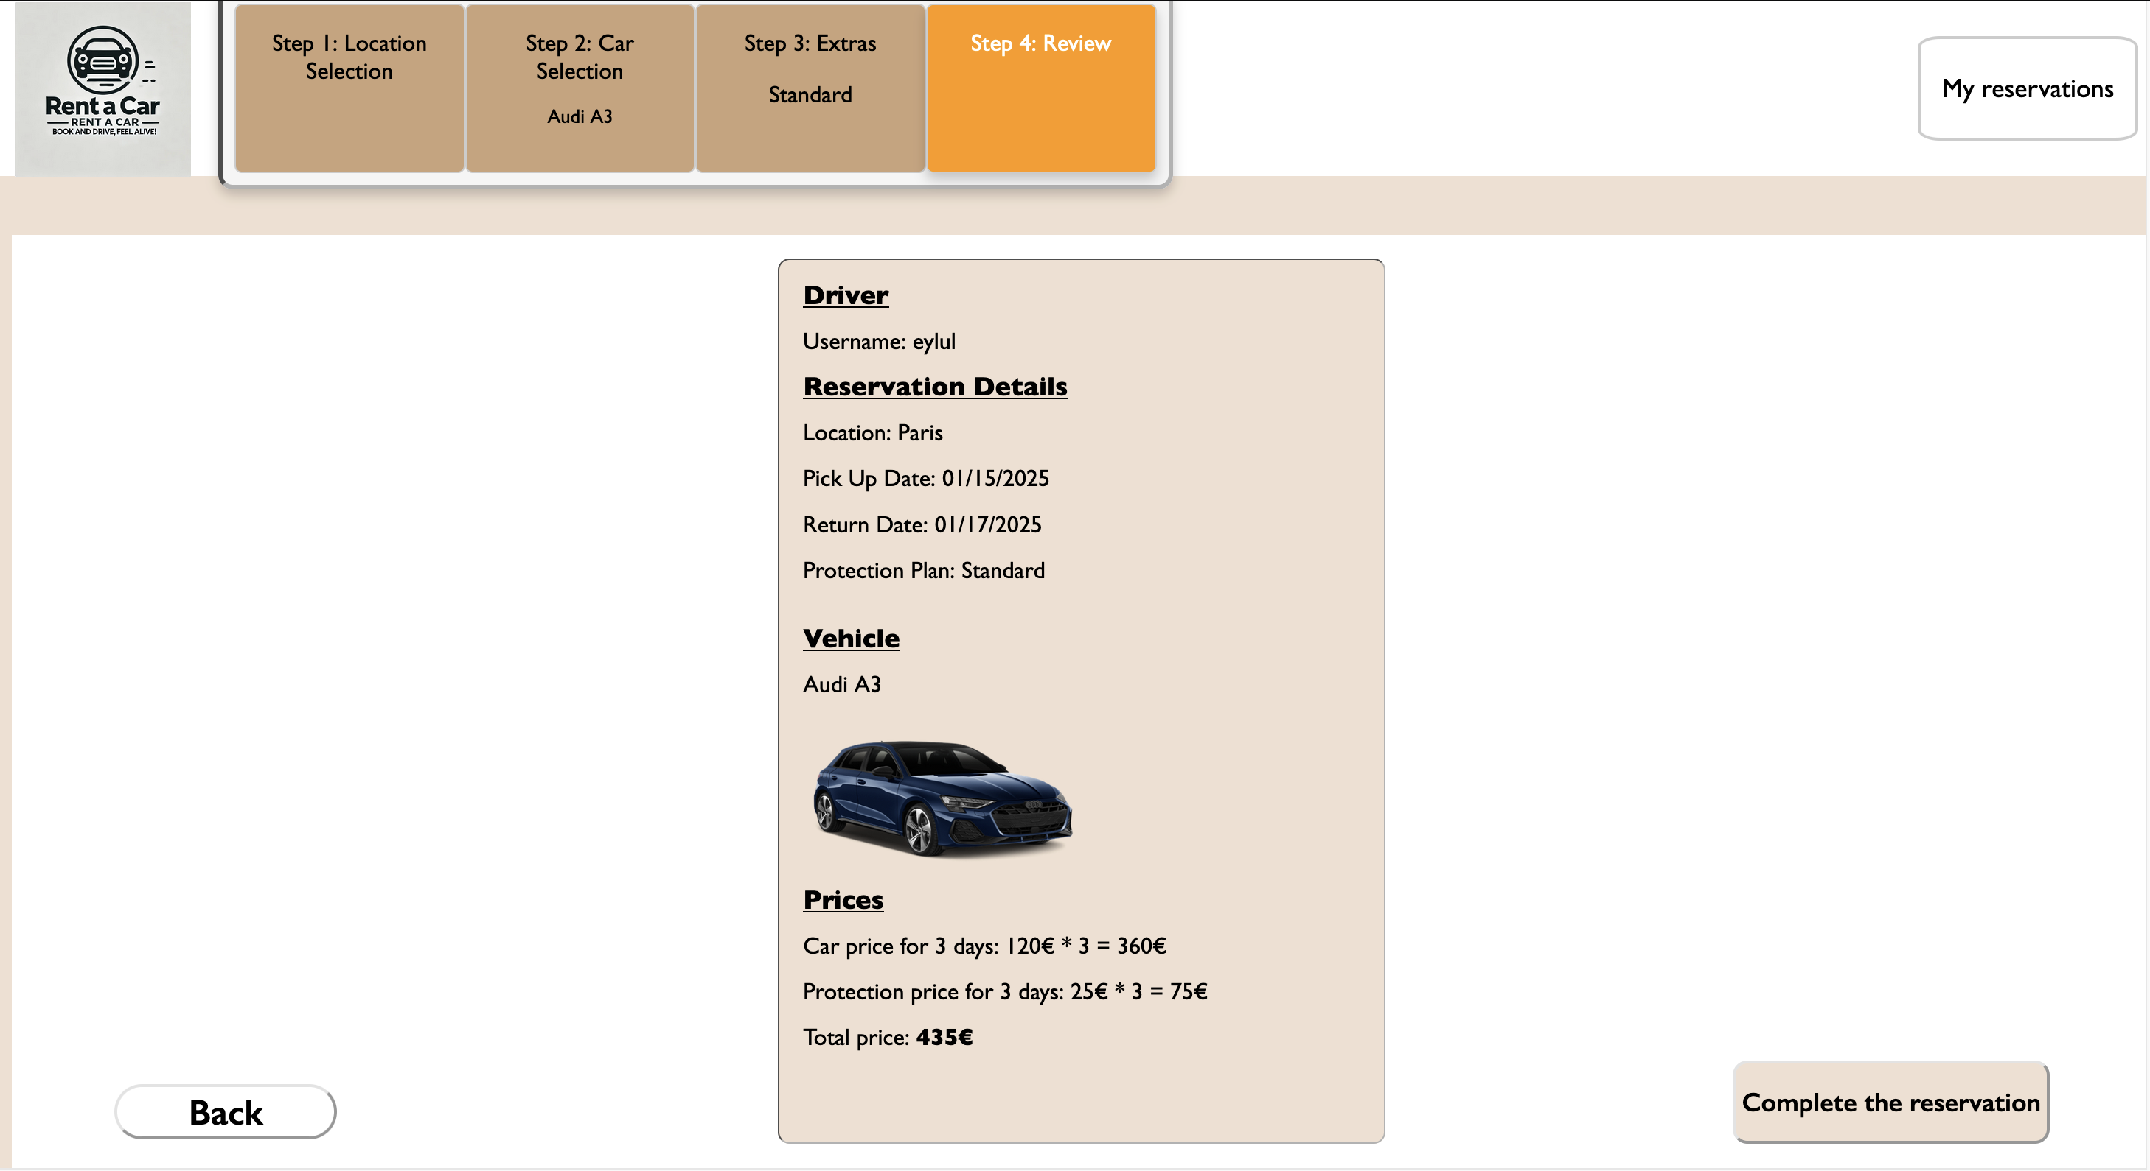
Location and date range selection in step 1
Selecting desired car using the available filters
Protection plans’ content and their prices
Review about the selected car and others

Slide 9
Differences with Proposal Design
Original Proposal | Changed | Reason for Change
There are options based on model, color, year, transmission type, and price range. | There are brand and transmission type filters. | It allowed to streamline the website's design and focus on the most relevant criteria for users.

Slide 10
